Slide 1
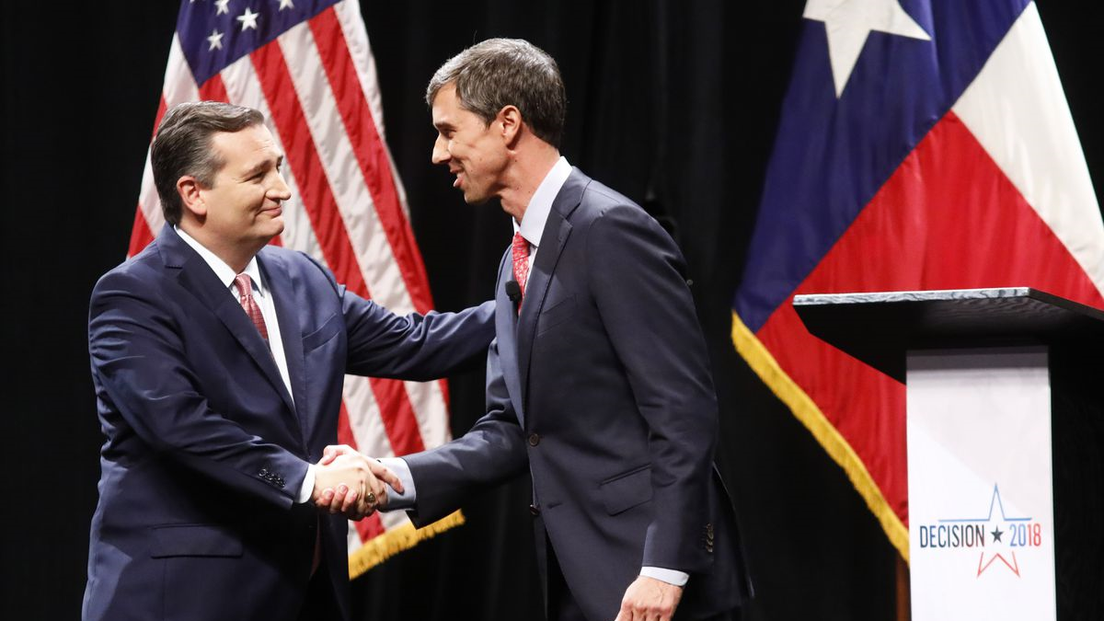

2018 Texas Senate Race
Apoorva Reddy | Abraham Khan
Avani Sharma | Alyson Brown
Jeffrey Fulkerson

Slide 2





Questions to answer
How much Twitter traffic is on our candidates?
What is the sentiment on each candidate?
Does traffic and/or sentiment differ by location?
What are the major topics related to each candidate?
What can we do with this information?

Slide 3



Data Collection & Preprocessing
Twitter API uses search terms (e.g. “Vote” “Cruz” and “Vote” “Beto”)
Tweets can be about one candidate, the other, or neither
100,000+ tweets nationwide, including retweets
Identify locations in Texas and in urban centers
Variables: username, location, text
Locations are entered by the users

Slide 4
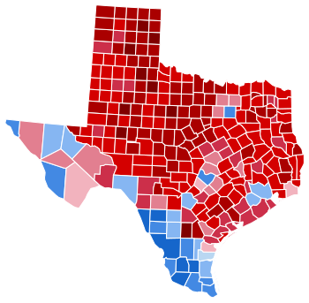
Lift Associations
Historically, Democratic candidates are commonly more popular in high population density areas
http://elections.sos.state.tx.us/elchist319_countyselect.htm

Slide 5
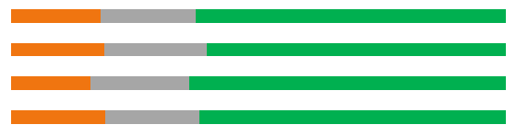

Sentiments
Cruz
Beto
Negative
Neutral
Positive
Nationwide
Beto
Texas
Urban Texas
Rural Texas
Nationwide
Cruz
Texas
Urban Texas
Rural Texas
Notes:
Beto nationwide sentiment = 0.12
Texas = .18
Urban = .18
Rural = .18
Cruz nationwide = .12
Texas = .17
Urban = .16
Rural = .17
Ratios
Nationwide = 1
Texas = 1.06
Urban Texas = 1.125
Rural Texas = 1.03

Slide 6
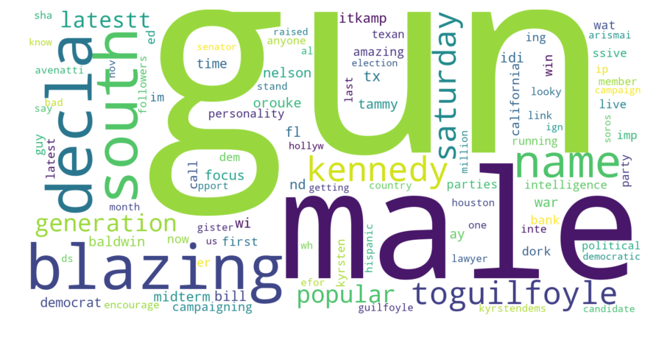
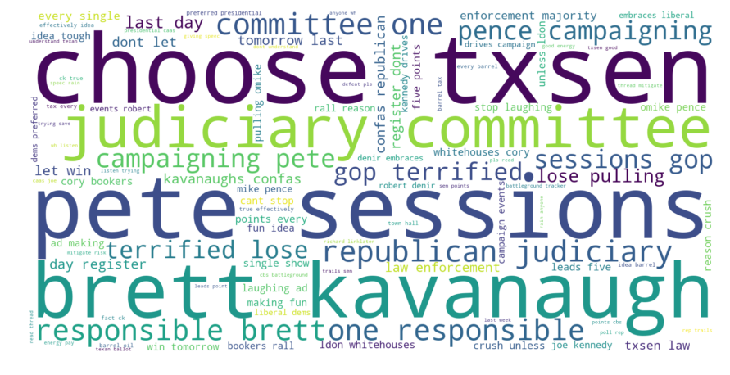
Obligatory word clouds
Beto O’Rourke
Ted Cruz

Slide 7
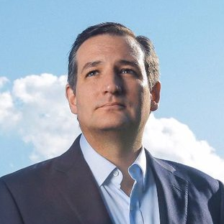
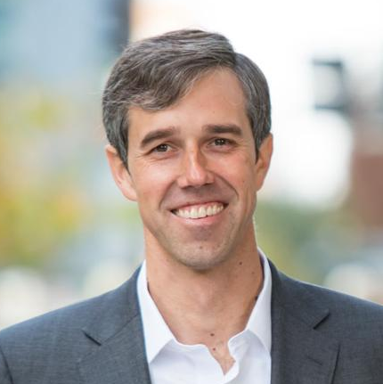
Topic Modelling
Race
Education
Guns & Oil
Crime
Civil Rights
Immigration
Democrat
Corporations
Speeches
Notes:
Beto
Civil Rights = 0.3
Education = .22
Crime = .12
Democrat = .1
Speeches = -0.001
Cruz
0=.129
1=.06
2=.22
3=.17
4=.08

Slide 8
Conclusions
Sentiment towards Beto is generally more positive in all regions
Ted Cruz is talked about more outside of large cities
Topics associated with each follow party lines
Ted Cruz is associated with people more than issues
The race is much closer in rural areas
Recommendation
Focus on issues that rural Texans care about
Notes:
People on twitter are more likely to be educated, aware, and live in denser areas.

